Slide 1



UNIT 4
LESSON 13
Living online
Part 2

Slide 2
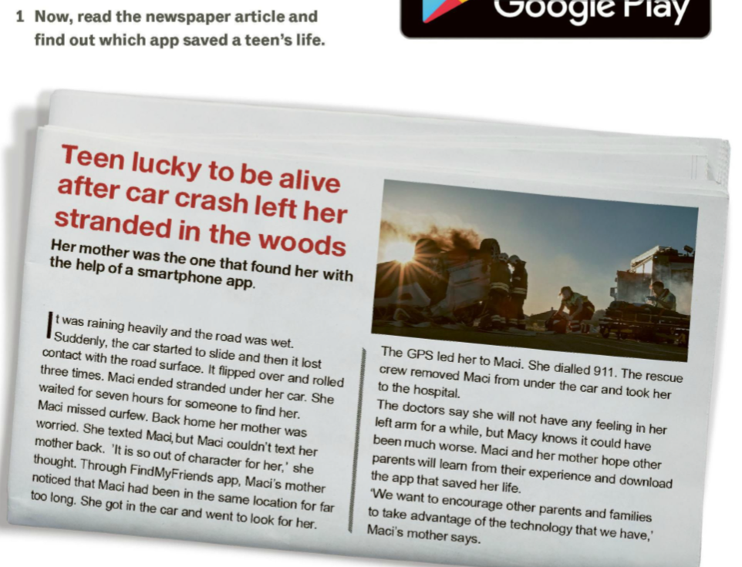
Smartphone app saves teen’s life.
What is a smartphone app?
What questions the headline rises?
What would you like to know?

Slide 3
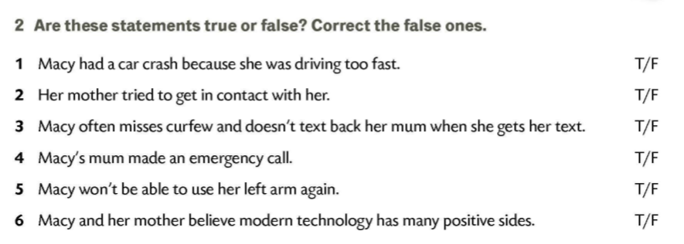
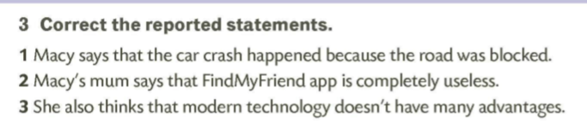
Why do car crashes happen?
1 Macy says that the car crash happened because the road was wet.
2 Macy’s mum says that FindMyFriend app is very useful.
3 She also thinks that modern technology has many advantages.
How can you reduce the risk of death in car accidents?

Slide 4
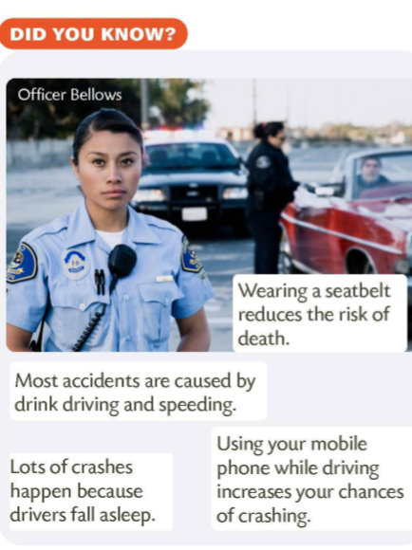
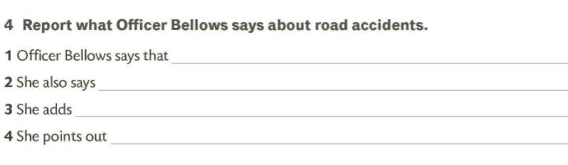
wearing a seatbelt reduces the risk of death.
most accidents are caused by drink driving and speeding.
lots of crashes happen because drivers fall asleep.
using your mobile phone while driving increases your chances of crashing.
Officer Bellows also says that she doesn’t let her daughter drive a car alone.
She also says that she believes teenagers should ride their bikes instead of driving cars.
’I don’t let my daughter drive a car alone.’
‘I believe teenagers should ride their bikes instead of driving cars.’

Slide 5
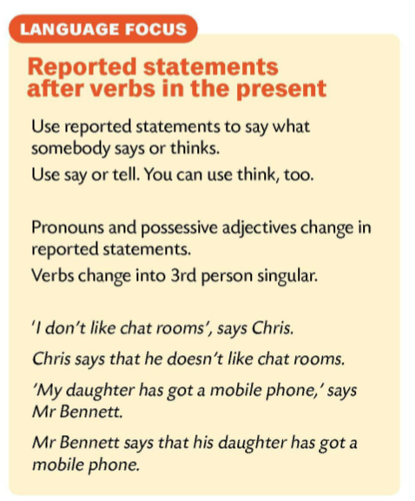
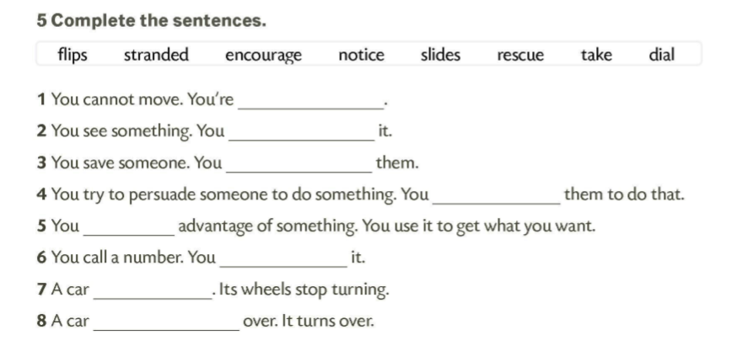
stranded
notice
rescue
encourage
take
dial
slides
flips

Slide 6
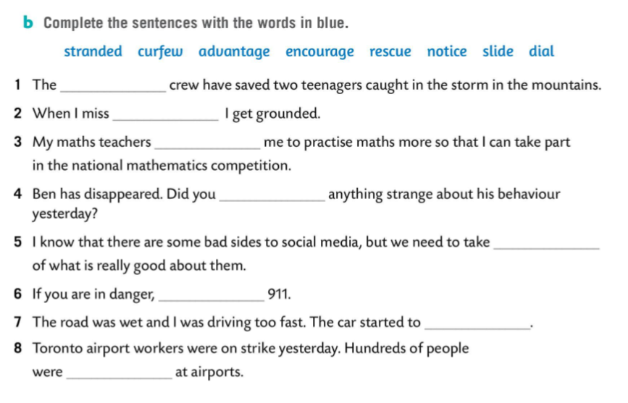
rescue
curfew
encourage
notice
advantage
dial
slide
stranded

Slide 7
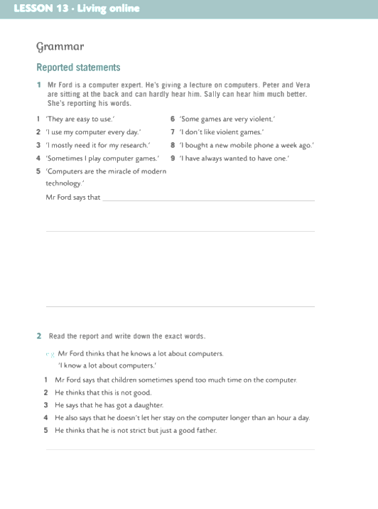
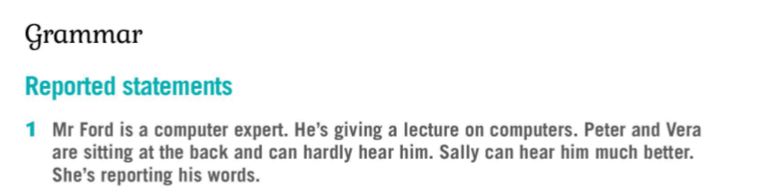
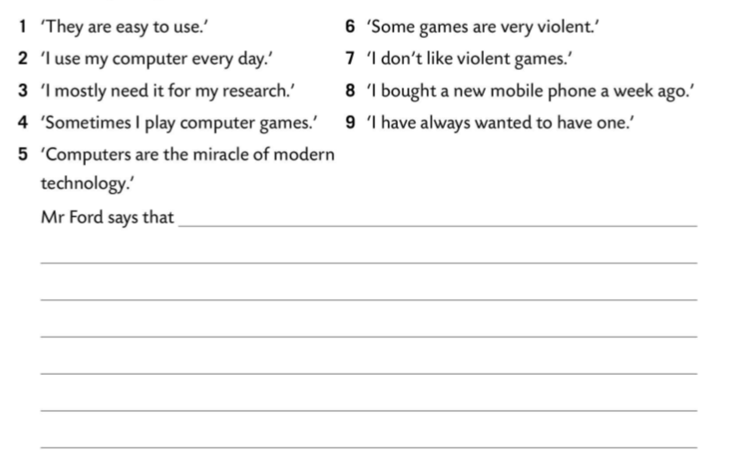
computers are easy to use.
2 He says that he uses his computer every day.
3 He says that he mostly needs it for his research.
4 He says that sometimes he plays computer games.
5 He says that they are the miracle of the modern world.
6 He says that some games are violent.
7 He says that he doesn’t like violent games.
8 He says that he bought a new mobile phone last week.
9 He says that he has always wanted to have one.

Slide 8
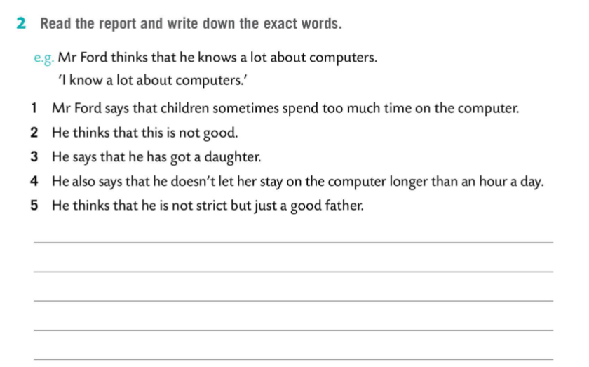

1 Sometimes children spend too much time on the computer.
2 This is not good.
3 I have got a daughter.
4 I don’t let her stay on the computer longer than an hour a day.
5 I am not strict but just a good father.

